Slide 1




E-FARMING
A Farmer's Friendly Application
Team: Tech Titans

Slide 2










TABLE OF CONTENT
Introduction
Objective
Features
User Roles
Technologies
System Architecture
Database Design
Conclusion

Slide 3


Introduction
E-Farming is an innovative application designed to bridge the gap between farmers and consumers. By leveraging technology, this platform empowers farmers to sell their products directly to consumers, eliminating the need for intermediaries and ensuring fresh produce for buyers. Our team, Tech Titans, has developed this application using a robust technology stack to facilitate seamless interaction between farmers and buyers.

Slide 4

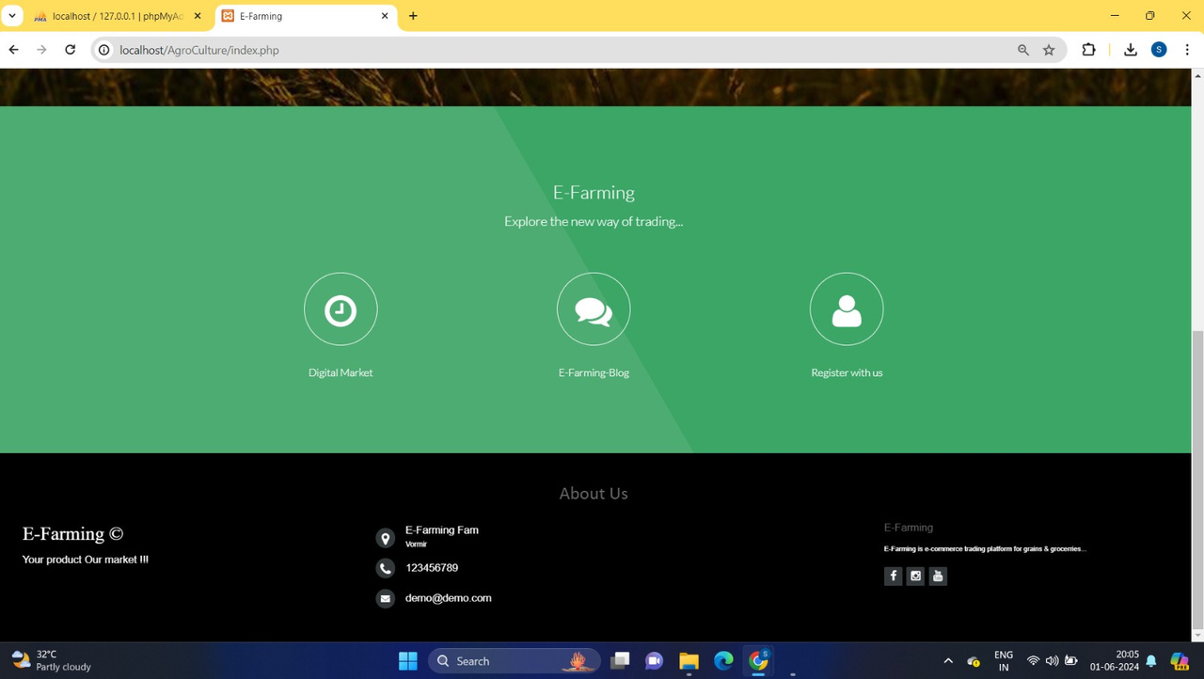
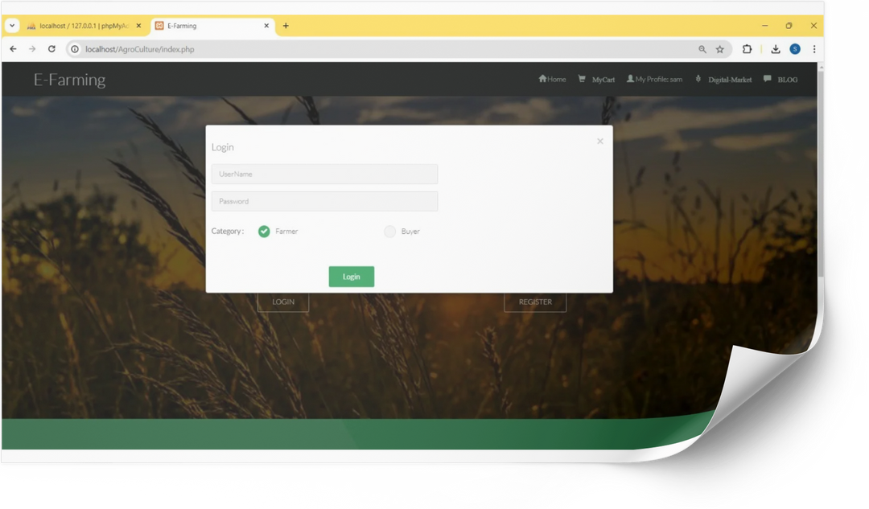
Objective
The primary objective of E-Farming is to create a user-friendly platform that benefits both farmers and consumers. For farmers, it provides a marketplace to sell their products, a platform to learn best farming practices, and a resource for purchasing seeds. For consumers, it offers direct access to fresh farm products.

Slide 5

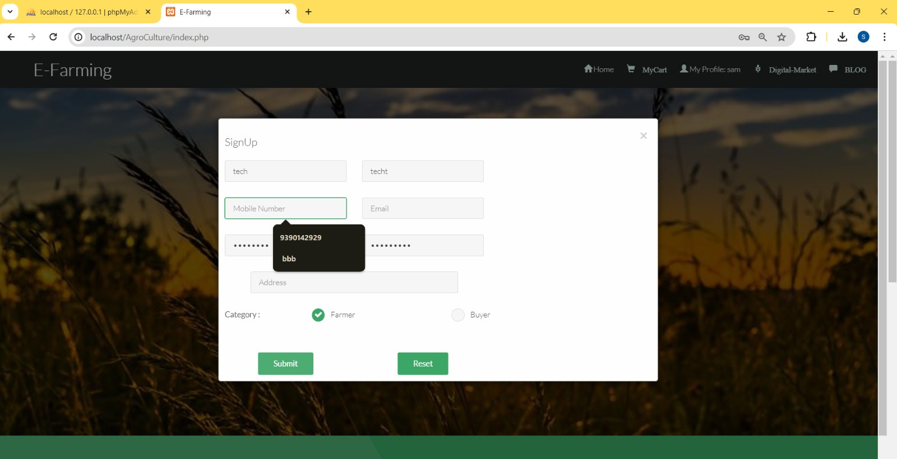
Our Feature
01
E-commerce Platform
Product Listing and product upload and selling /buying: Farmers can list their products with detailed descriptions, prices, and quantities.
Search and Filter: Users can search for products and apply filters based on categories, price range, and other criteria.
Order Management: Users can place orders, and farmers can manage these orders from their dashboard.
Payment Gateway : Secure payment options for seamless transactions.

Slide 6
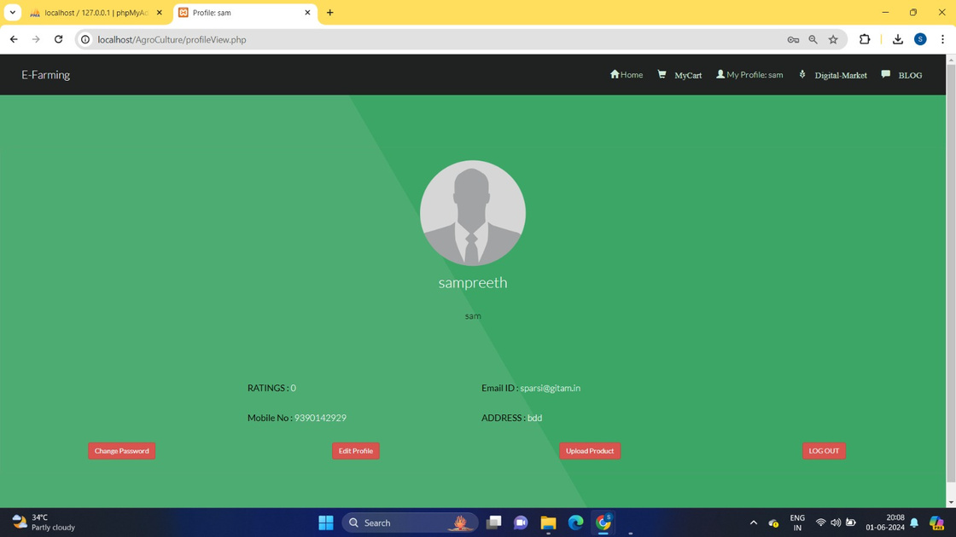
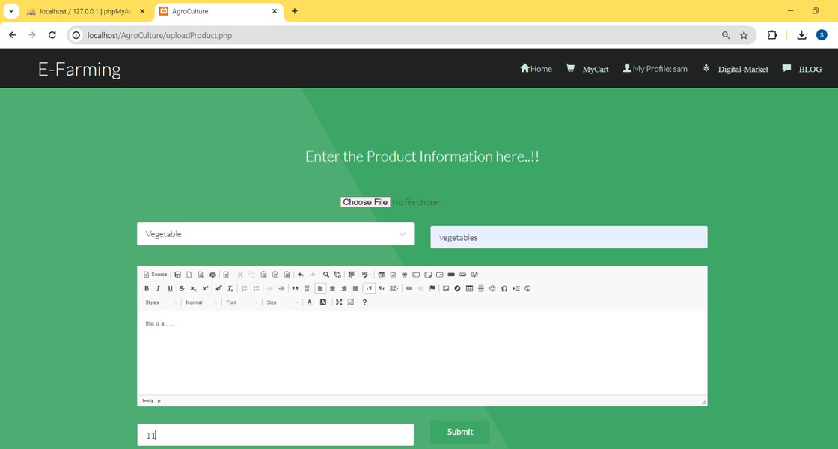
02
Blog and Training
Our Feature
Blog Section: Farmers can read and contribute to blogs about various farming techniques, success stories, and best practices.
Training Modules: Interactive training sessions and video tutorials to help farmers improve their skills.
03
Product Purchase and Information
Products Catalog: Farmers can browse and purchase products directly through the platform.
Products Details: Detailed information about each products type, including usage instructions, required conditions, and potential yields.

Slide 7
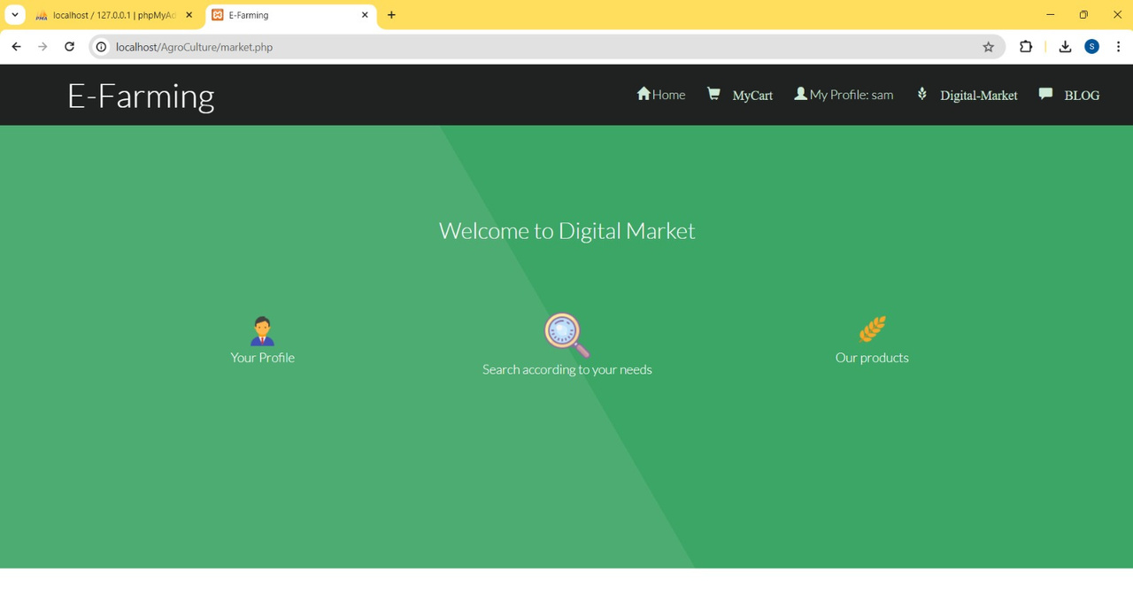

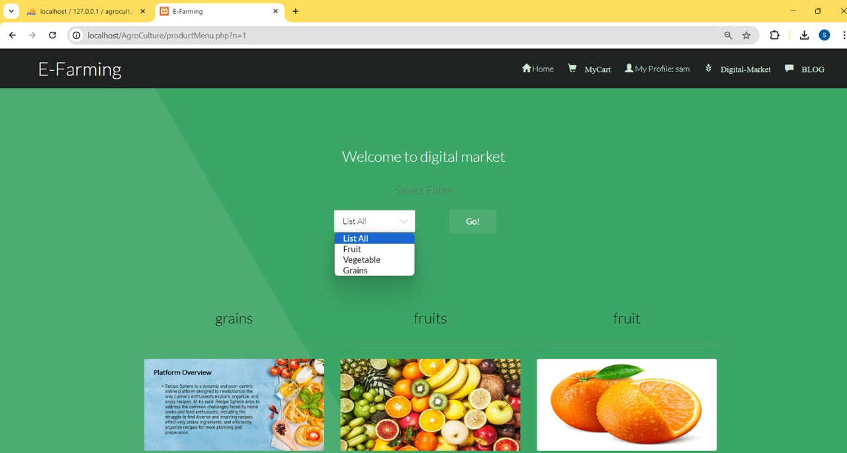
User Roles
Farmer
Profile Management: Farmers can create and update their profiles, including personal information and farm details.
Product Management: Ability to add, update, and remove products from the marketplace.
Order Tracking: Track orders placed by consumers.
Access to Blog and Training: Participate in the blog section and access training modules.
Buyer
Profile Management: Buyers can create and manage their profiles.
Product Browsing and Purchasing: Browse available products and make purchases.
Order Tracking: Track the status of their orders.

Slide 8
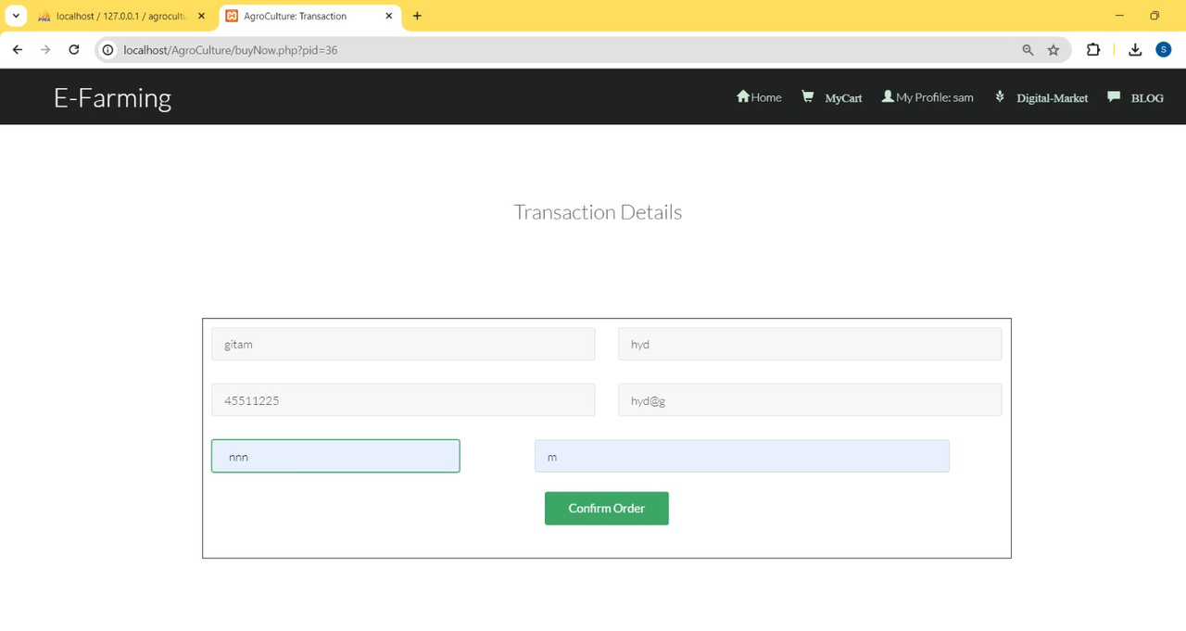
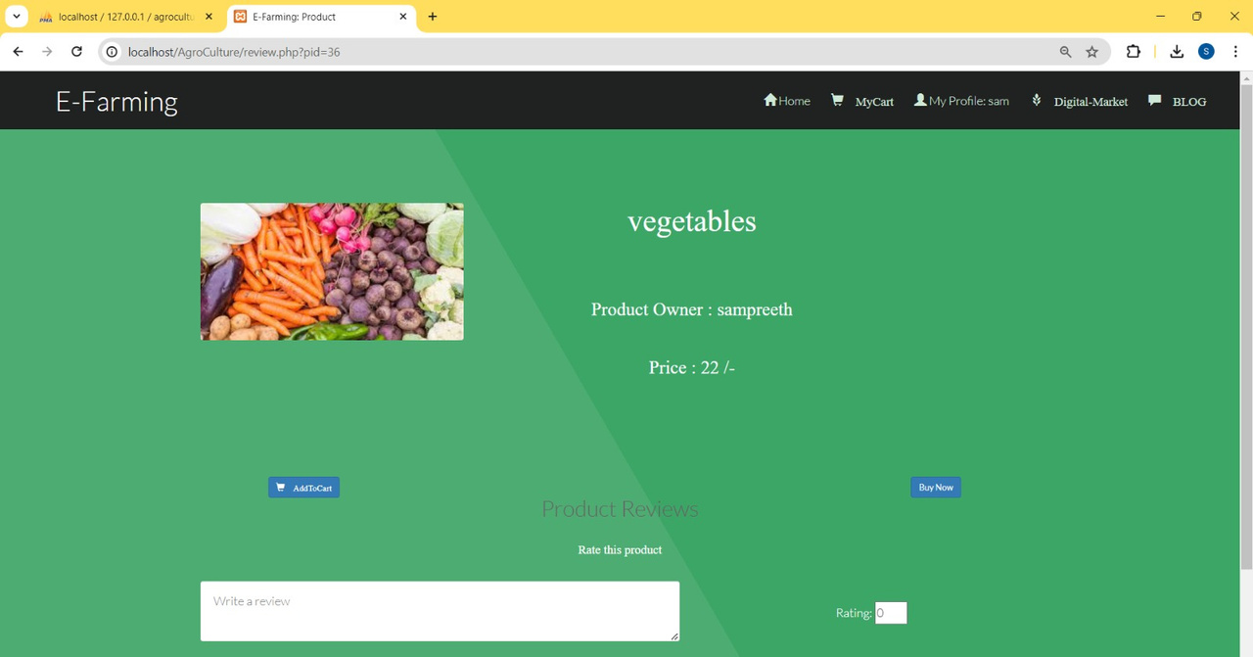
User Roles
Admin
User Management: Manage farmer and buyer accounts, including creating, updating, and deleting accounts.
Product Management: Oversee product listings and ensure they meet platform standards.
Content Management: Monitor and manage blog content and training modules.
Order Management: Oversee order processes and resolve any issues

Slide 9
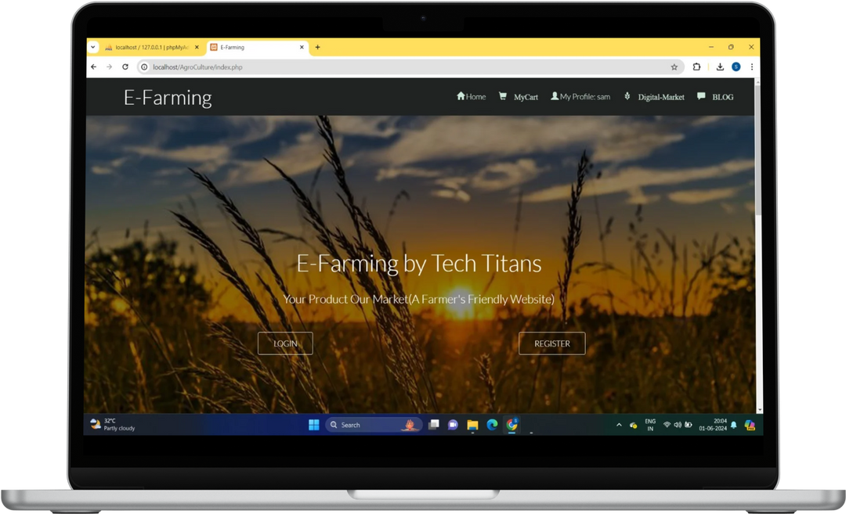


Technologies Used
Front-end: HTML, CSS, JavaScript, jQuery
Back-end: PHP
Database: MySQL
Github Link

Slide 10
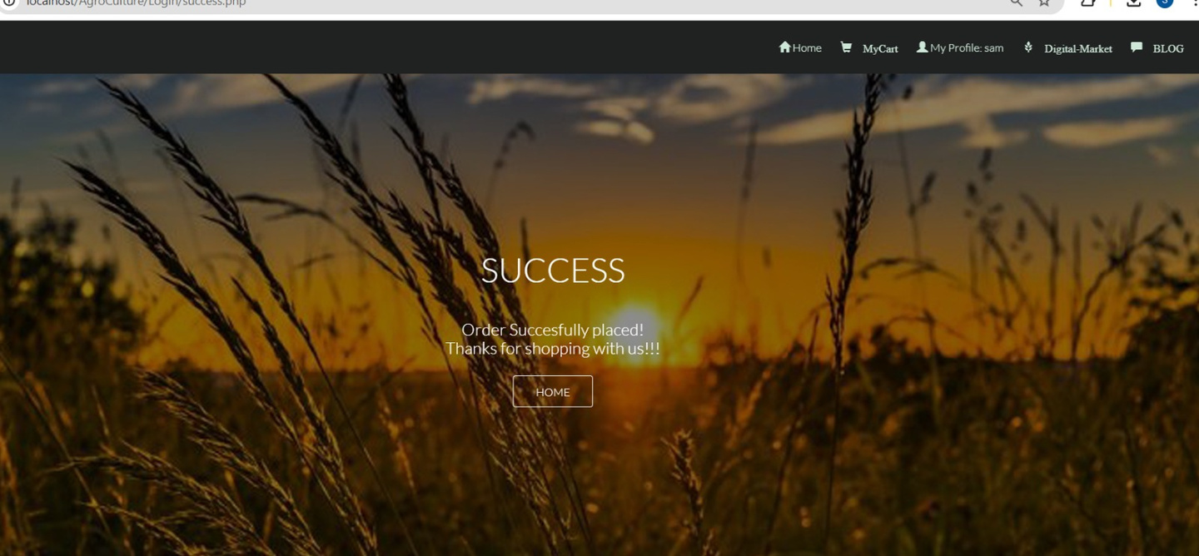

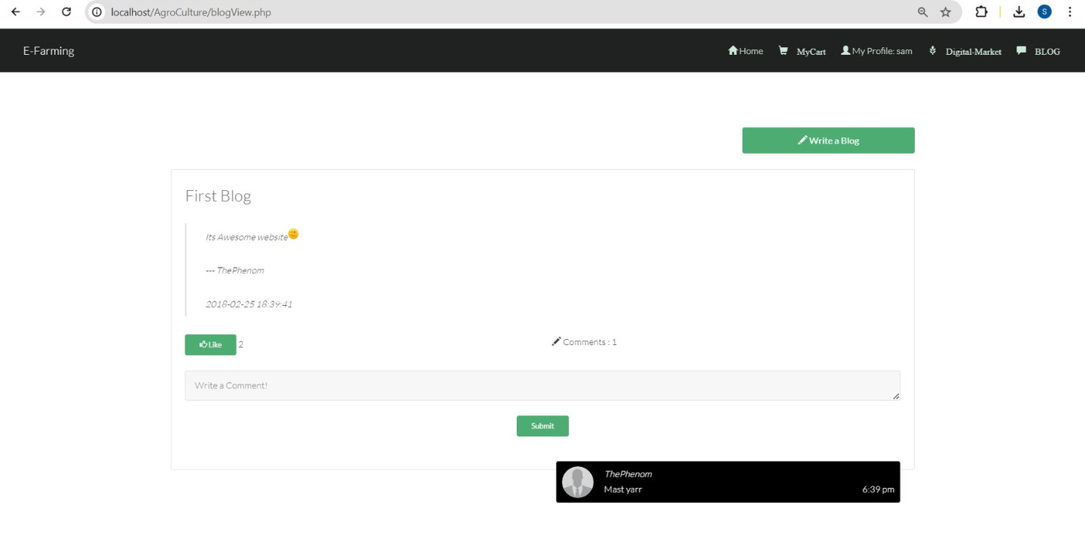
System Architecture
The system architecture of E-Farming is designed to ensure scalability, security, and performance. The application follows a three-tier architecture:
Presentation Layer: HTML, CSS, JavaScript, and jQuery are used to create a responsive and user-friendly interface.
Business Logic Layer: PHP is used to handle the business logic, including user authentication, product management, and order processing.
Data Layer: MySQL is used to store and manage application data, ensuring data integrity and security.

Slide 11
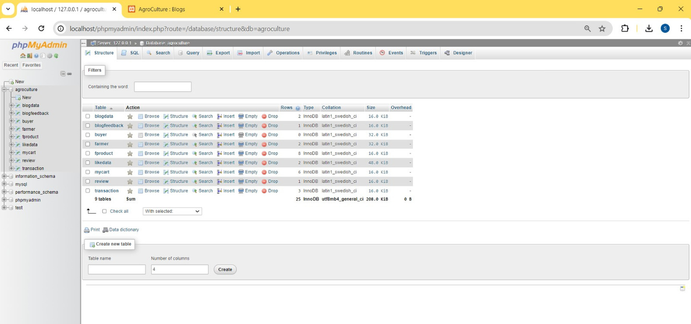

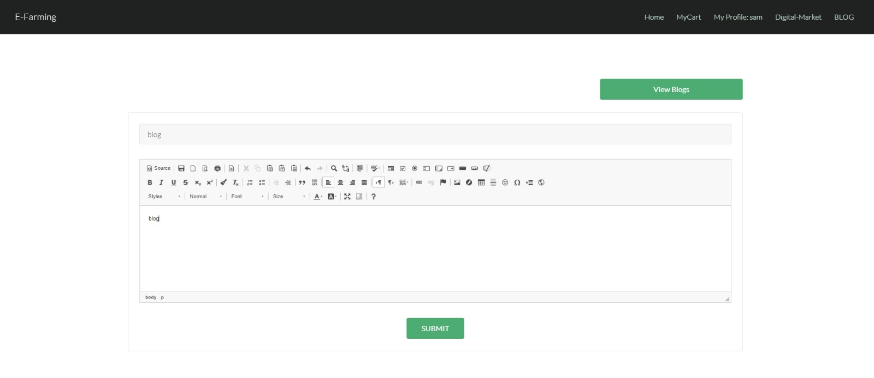
Database Design
The database is structured to efficiently manage users, products, orders, and blog content. Key tables include:
Users: Stores information about farmers and buyers.
Products: Contains details about the products listed by farmers.
Orders: Manages order information and statuses.
Blogs: Stores blog posts and comments.
Products: Contains information about products available for purchase.

Slide 12

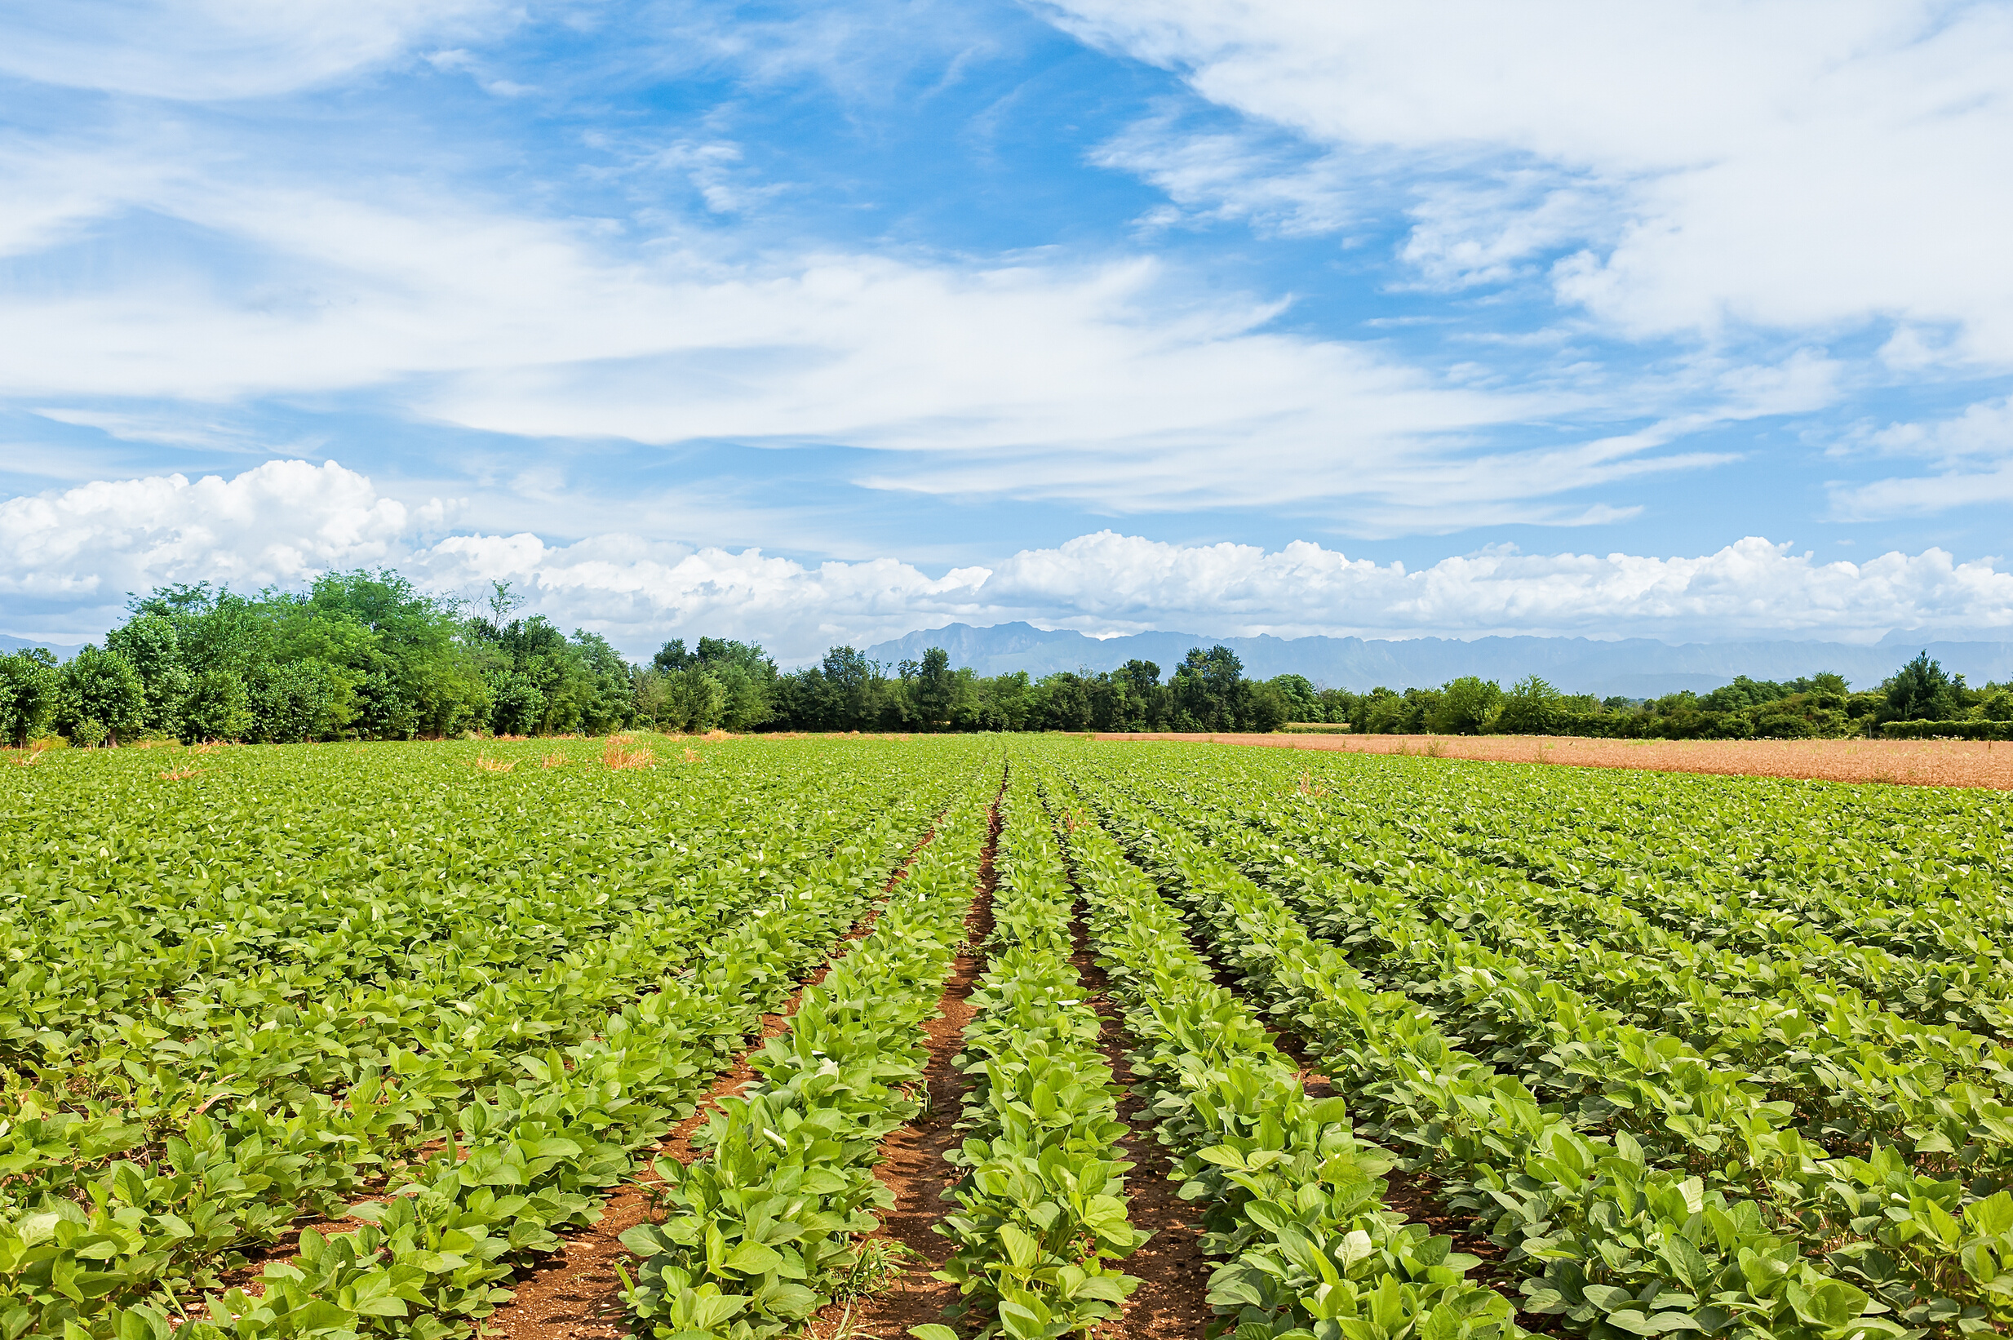
Conclusion
E-Farming aims to revolutionize the agricultural sector by providing a platform that connects farmers directly with consumers. By incorporating features such as a marketplace, educational resources, and seed purchasing options, we strive to enhance the productivity and profitability of farmers while offering consumers fresh, high-quality products. The application, developed by Tech Titans, leverages modern web technologies to deliver a robust, user-friendly experience

Slide 13
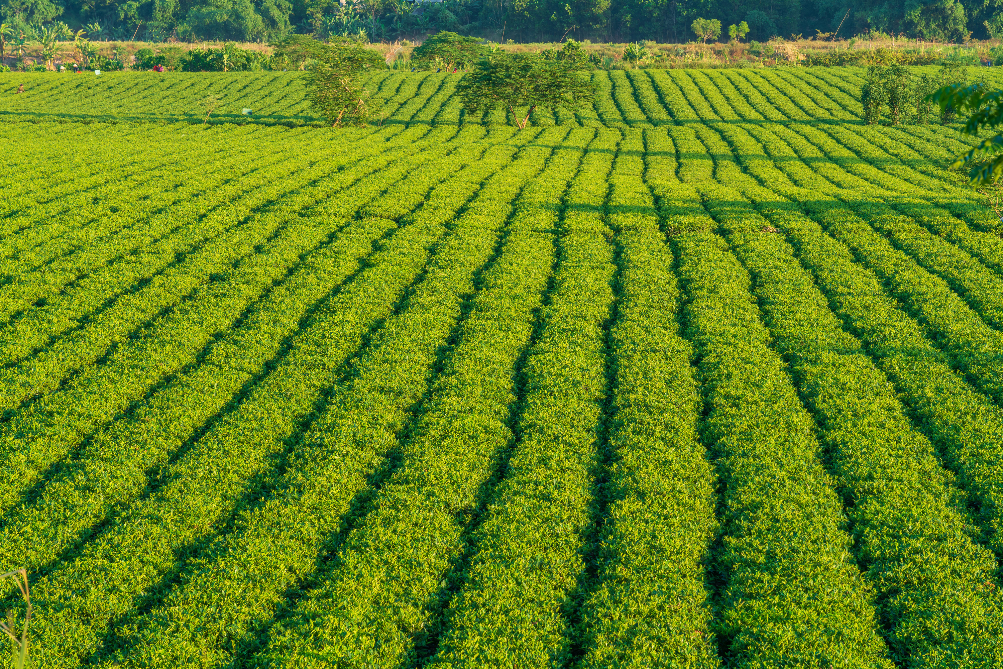

THANK
YOU
Team, Tech Titans
Sampreeth parsi - HU21CSEN0101411
Moksha Sai K - HU21CSEN0101291
Karthik Pagidi - HU21CSEN0100708
Manikantha K - HU21EECE0100311
Yashaswi Rekha - HU21CSEN0101262

